Slide 1
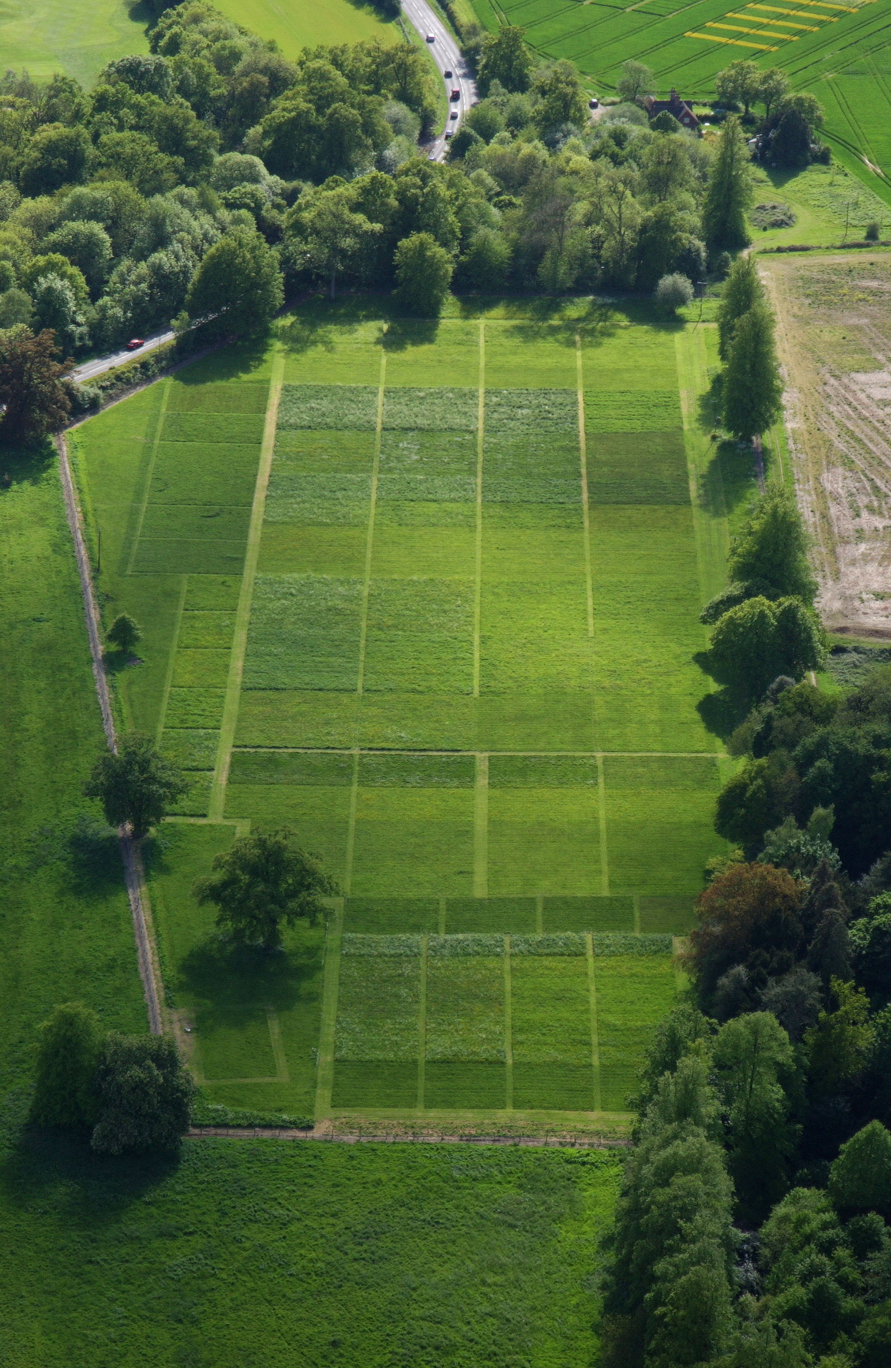

A celebration of 150 years of the
Park Grass Experiment
Rothamsted Research

Slide 2
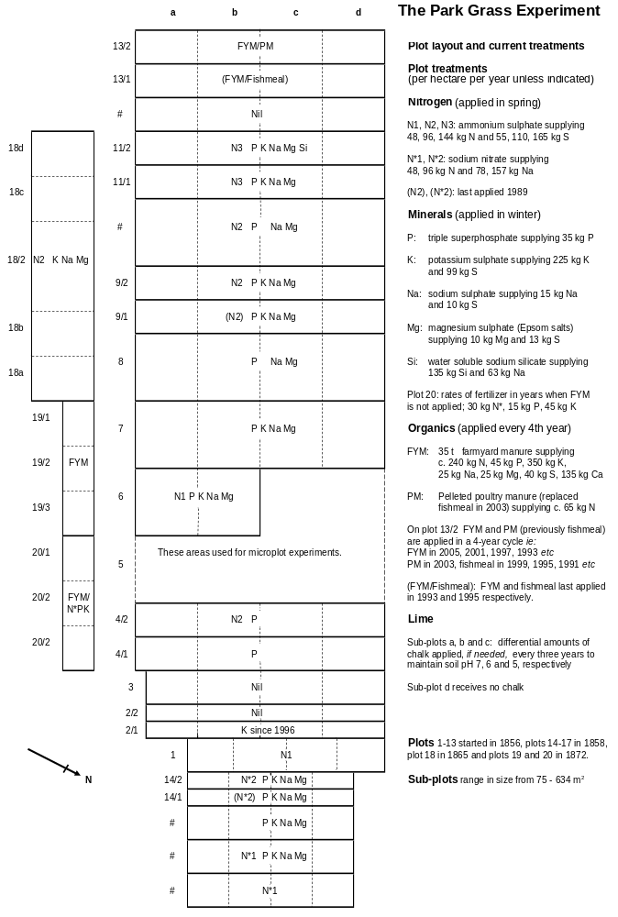

Slide 3
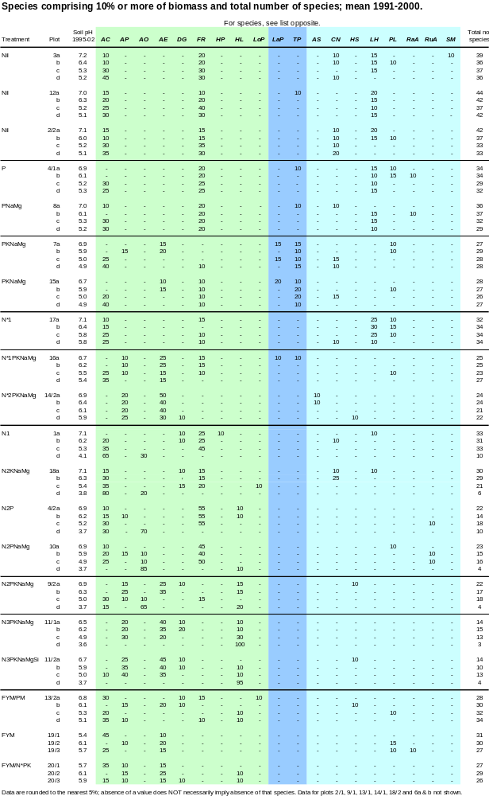

Slide 4
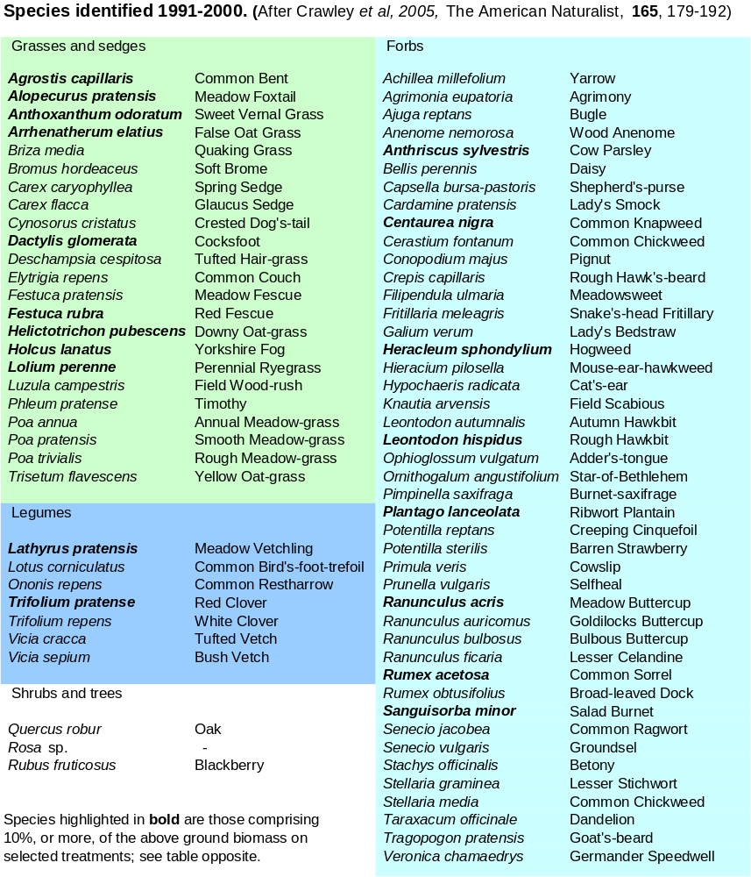

Slide 5
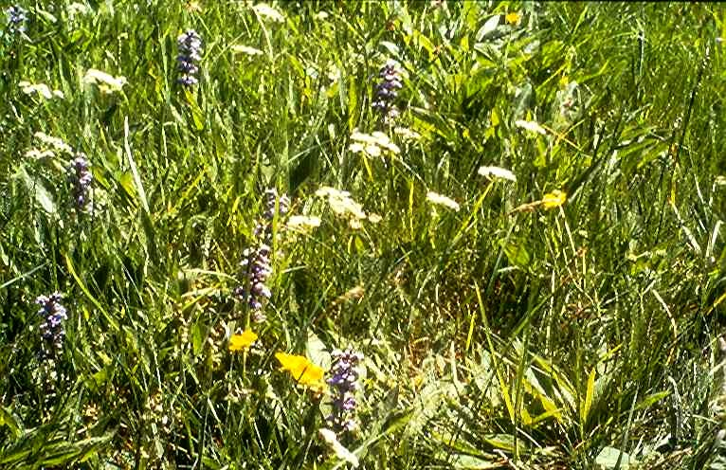
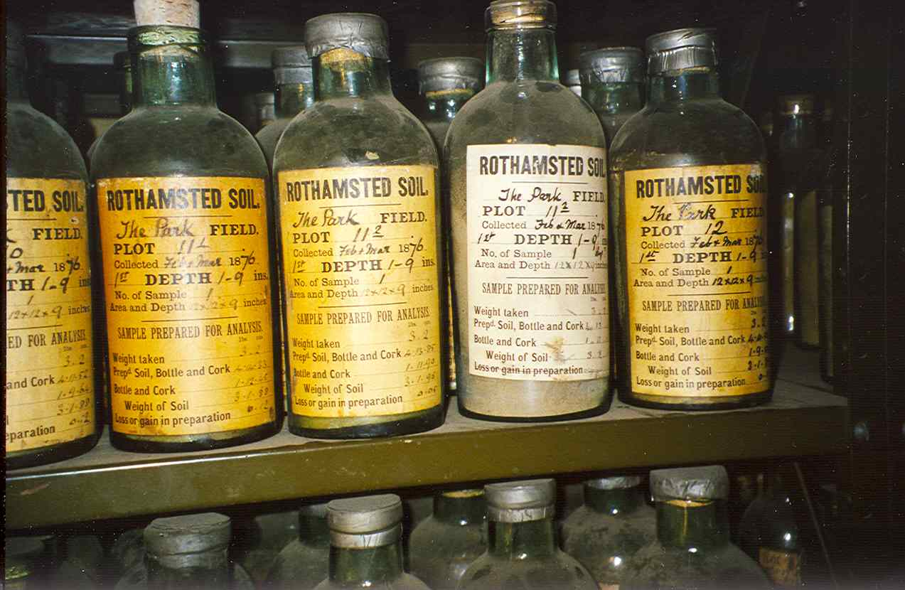
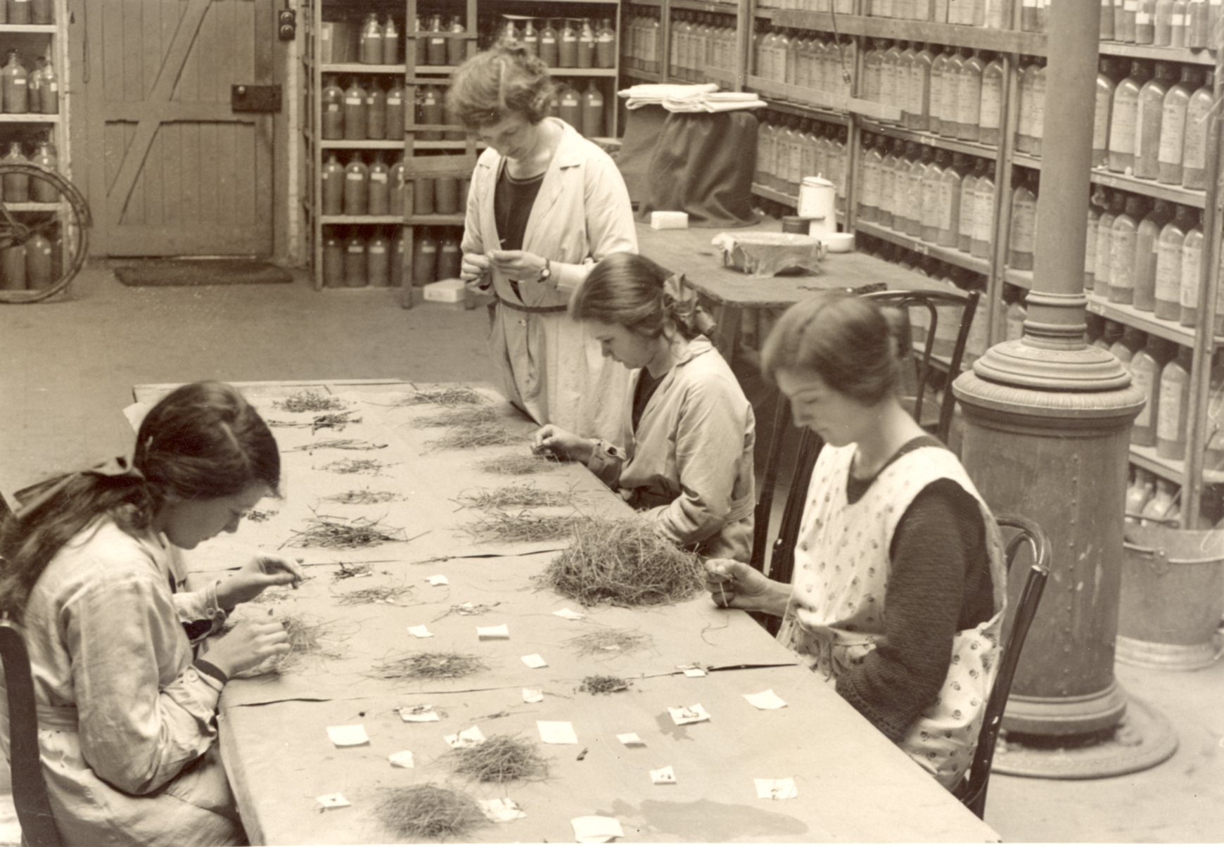
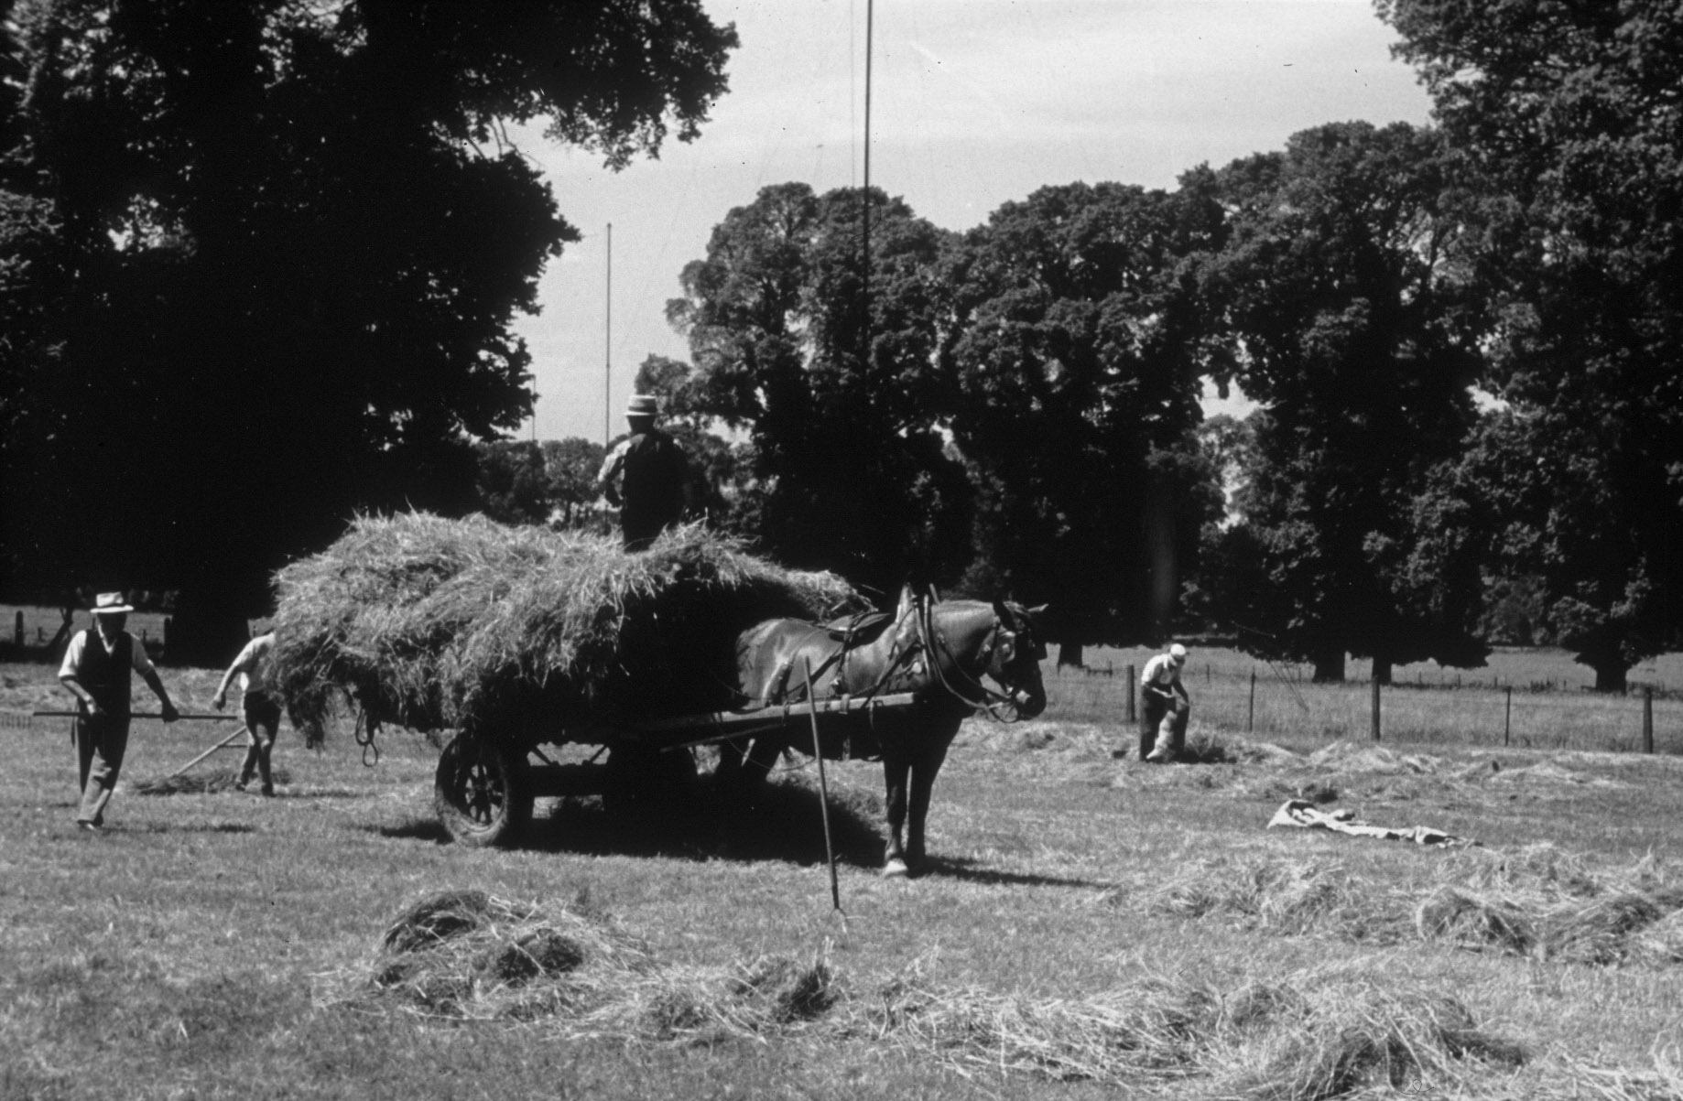
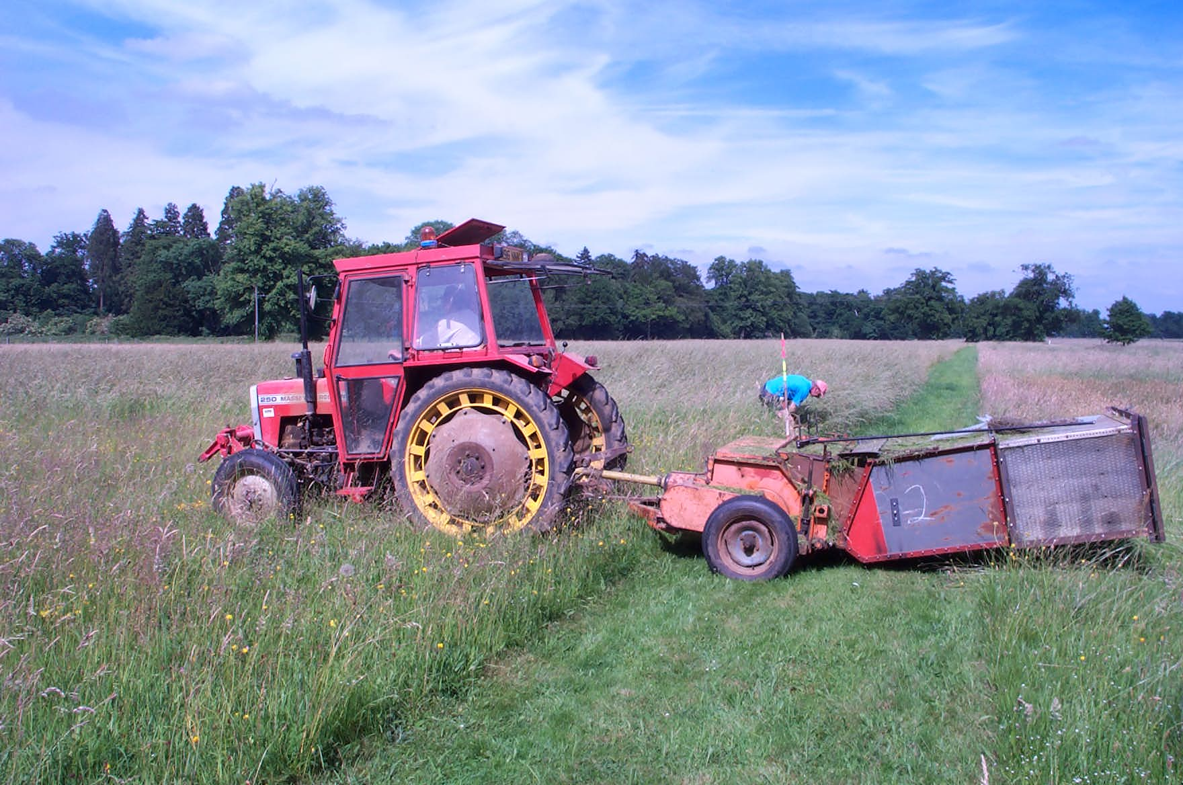
Archived soils
from 1876
Grass sorting 1930s
Harvesting 1941
Harvesting 2005
Rothamsted Research
Harpenden
Herts AL5 2JQ
Tel: +44 (0) 1582 763133
Fax: +44 (0) 1582 760981
Web: http://www.rothamsted.ac.uk

